Slide 1
Exception handling

Slide 2
Overview
What is an exception?
Example of an exception
Exception handling
Handling/Catching exceptions
Variant of try-catch - try-catch-finally
Types of exceptions
Pokémon exception handling
Throwing exceptions
Best practise dealing with exceptions
Creating your own exception type
Storing exceptions
Saving to file
Saving to database
Saving to event viewer
Reading and understanding stack traces
Introduction to debugging in Visual Studio
Writing to a file
Reading from a file

Slide 3
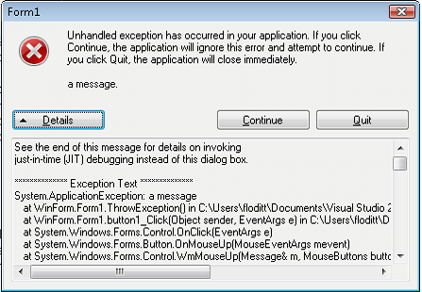
What is an exception?
An exception is an event, which occurs during the execution of a program, that disrupts the normal flow of the program’s instructions.
When an error occurs within a method, the method creates an object and hands it off to the runtime system.
The object is called an “exception object” and contains information about the error and the state of the program when the error occurred.
Creating an exception object and handling it to the runtime system is called “throwing an exception”.

Slide 4
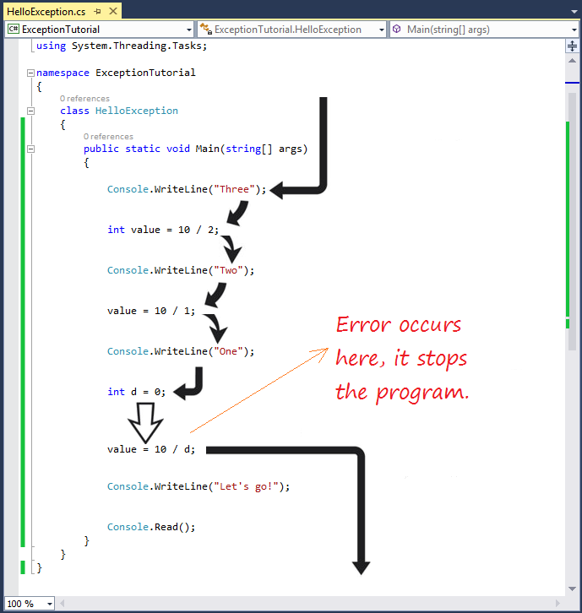
Example of an exception

Slide 5
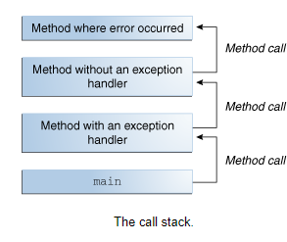
Exception handling
After a method throws an exception, the runtime system attempts to find something to handle it.
The “something” to handle it is an ordered list og methods that has been called to get to the method where the error occurred (the list is known as the “call stack”).
The runtime system searches the call stack for a method that contains a block of code that can handle the exception. This block of code is called the “exception handler”.
The exception handler is said to “catch the exception”.

Slide 6
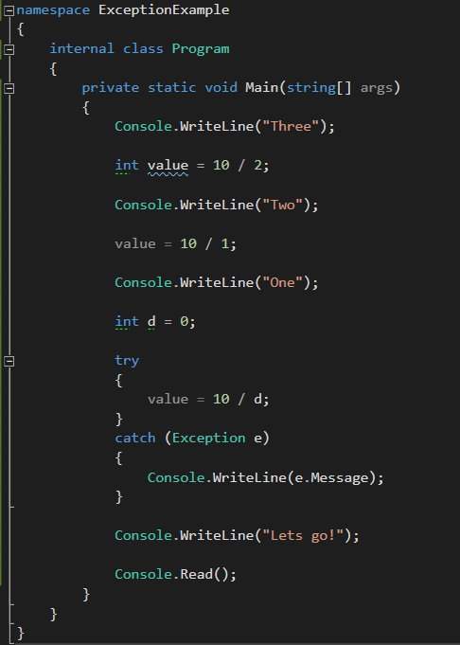
Handling/Catching exceptions
When an exception is thrown, the CLR looks for the catch statement that handles the exception.
If no exception is found, then the CLR displays an unhandled exception message to the user and stops execution of the program.
We can use try-catch blocks to “catch” the exception.
The code inside of the “try” block contains the guarded code that may cause an exception.
The “catch” block contains the code that should be executed if an exception of the type in the “catch” block is thrown.
When you catch an exception the program execution does not stop. Unless you decide to throw an exception inside of the catch block.

Slide 7
Exercise try-catch
Create a new console application.
Try to divide by zero to get the exception to be thrown (just like I did in the previous code example).
Catch the exception and write a message to the console window inside of the catch block.
If you have time, try to make another exception occur and try to catch it.

Slide 8
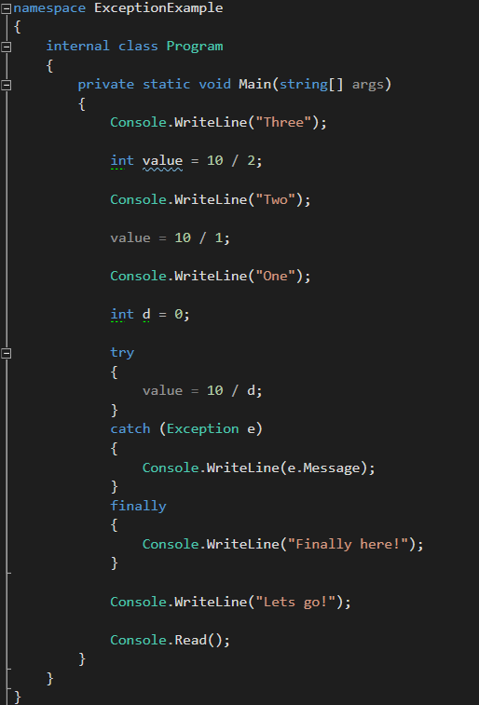
Variant of try-catch - try-catch-finally
Try-catch-finally is an variant of the try-catch syntax.
Try-catch-finally enables us to execute a block of code whether an error was thrown or the code that was executed successfully in the “try” block.
The main reason to use a finally block is to clean up resources that would otherwise not be cleaned by the garbage collector, an example could be closing a SQL connection.

Slide 9
try-catch-finally exercise
Take the console application we created before and add a finally block to it.
Inside of the finally block, write something out to the console, to show that we hit the execution block.
Try to change the code so the “DivideByZeroException” is not thrown, see if the finally block is still being executed.
Think about where the finally block can be used.

Slide 10
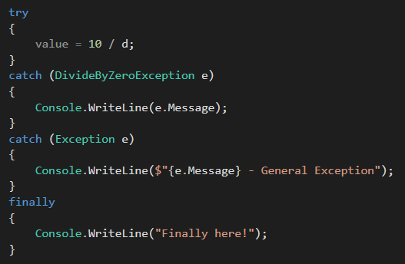
Types of exceptions
The .NET framework has many different types of exceptions.
It is important to know the different types of exceptions to be able to handle each of them.
Example of an exception type, is the “DivideByZeroException”. The exception is thrown when the program tries to divide by zero.
When working with different types of exceptions it is important to catch the most specific exception.

Slide 11
Exercise types of exceptions
Take the console application we created before.
Instead of catching all exceptions try to catch the “DivideByZeroException” type followed by the “Exception” type.
Write something inside of the “DivideByZeroException” block to display that it is being hit and the “Exception” type block is not.
If you have time try to change the order of the “catch” block so that the type “Exception” is before the type of “DivideByZeroException”, which catch block is now being executed?

Slide 12
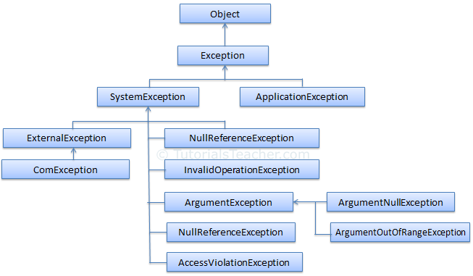

Slide 13

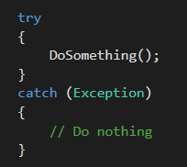
Pokémon exception handling is a code smell where the programmer wraps all his code inside of try-catch blocks and either does nothing with it or tries to handle every single exception in a generic manner.
Leads to code that is hard to debug and therefore maintain.

Slide 14
Throwing an exception
In C# you can throw exceptions yourself by using the “throw” keyword example:
throw new ArgumentException("Whops, the argument you passed to the method is not valid");
When an exception is thrown the runtime searches for the most compatible exception handler (catch block).
Programmers should throw exception when one or more of the following conditions are true:
The method cannot complete its defined functionality.
An inappropriate call to an object is made, based on the object state.
When an argument to a method causes an exception.

Slide 15
Throwing an exception
Create a new console application.
Try to throw an exception of type “ArgumentException” in the main method.
If you have time, try to look up different exception types and try to throw them in the application.

Slide 16
Best practise dealing with exceptions
A well designed application handles exceptions and errors to prevent crashes.
Use try-catch-finally blocks around code that can potentially generate an exception.
In catch blocks, always order exceptions from the most specific to the least specific.
Use a finally block to clean up resources, whether you can recover or not.
For conditions that are likely to occur it might be better NOT to trigger an exception, consider handling them in a way that will avoid the exception.
Use exception handling if the exception doesn't occur very often.
Check for error conditions in code if the event happens routinely and could be considered part of normal execution.
Use predefined .NET exception types.
Example could be to throw an “InvalidOperationException” if a property set or method call is not appropriate given the objects current state.
Throw an “ArgumentException” if invalid parameters are passed.

Slide 17
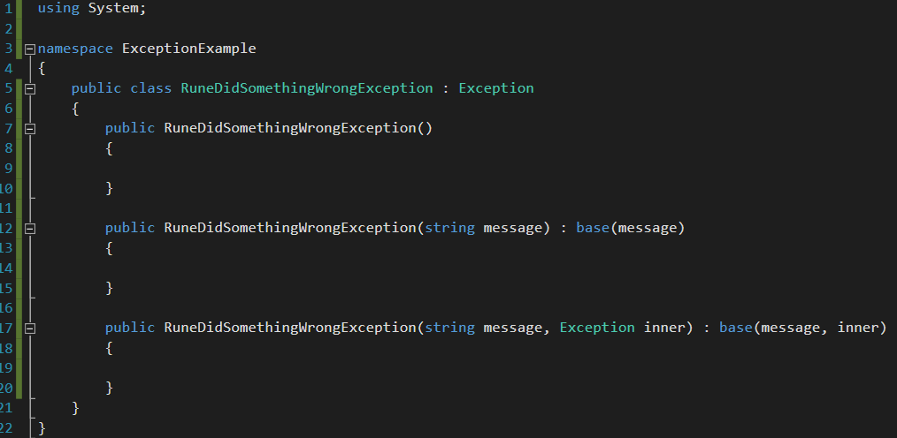
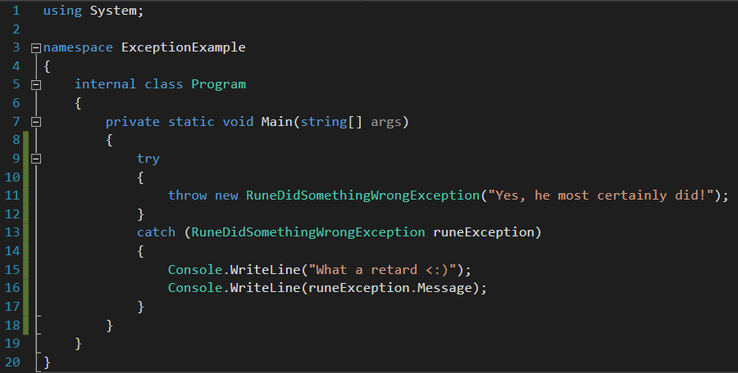
Creating your own exception type
Programs can throw a predefined exception class in the “System” namespace, or create their own exception classes by deriving from “Exception”.
The exception can then be used just like all the .NET exceptions.

Slide 18
Storing exceptions
Most of the exceptions that will be thrown in our application will be unhandled.
When an exception is thrown in our application, it is a good idea to store it, so it can be used for reference to handle the exception or to reason about why it did occur.
There are a few way to persistently store our exception, the most used are saving file and database.
Saving to file
Saving to database
Saving to event viewer
It is important to save the stacktrace, the exception type and the exception message.

Slide 19
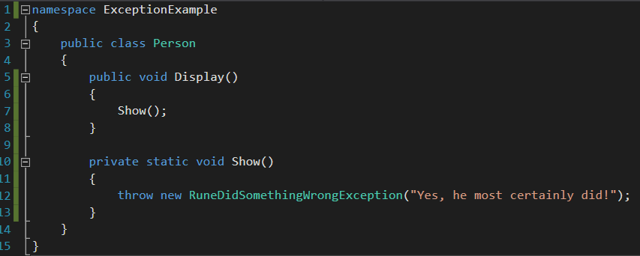
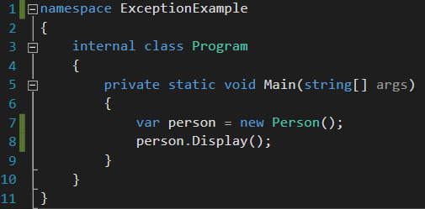
Reading and understanding stack traces example one

Slide 20
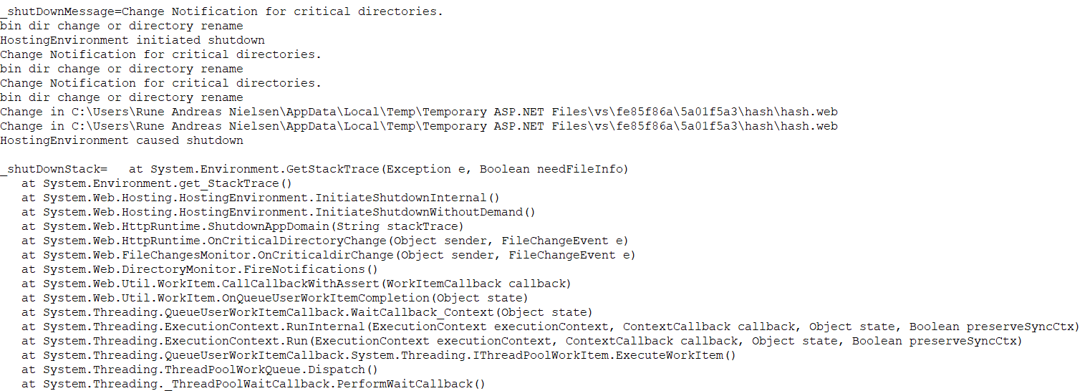
Reading and understand stack traces example two

Slide 21
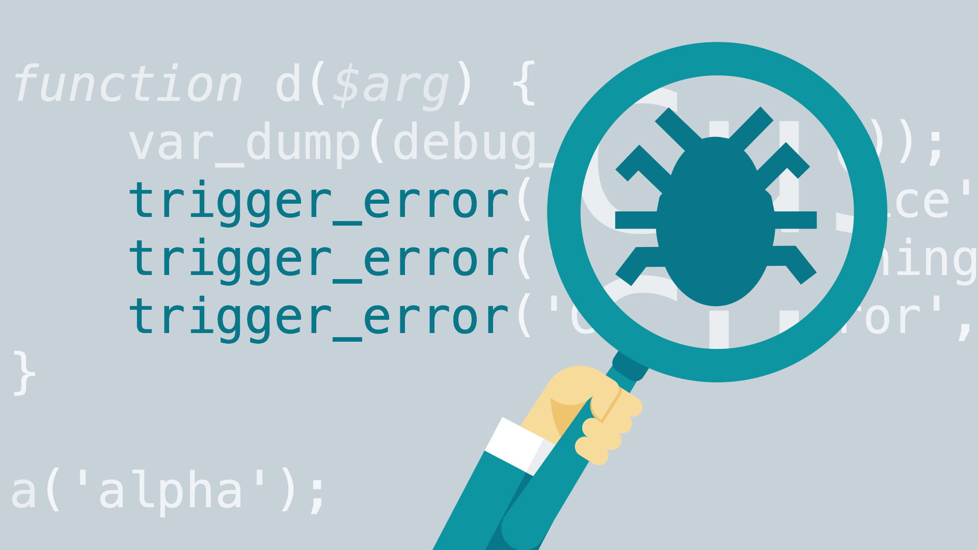
Introduction to debugging in Visual Studio

Slide 22
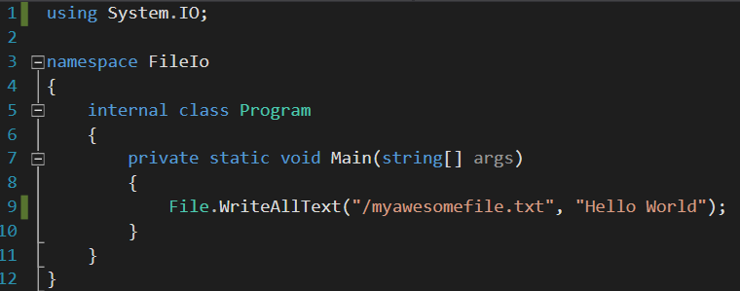
Writing to a file

Slide 23
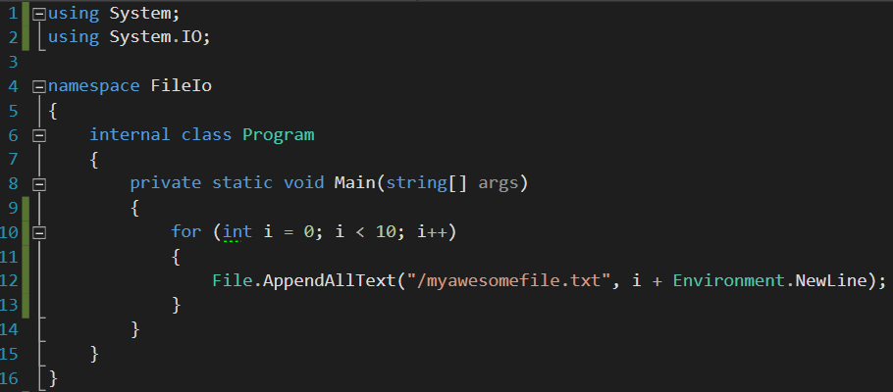
Append text to file

Slide 24
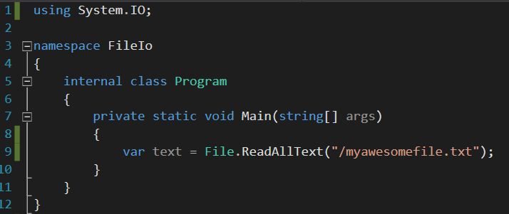
Reading from file

Slide 25
Writing to file and reading from file exercise
Create a new console application (remember to run visual studio in administrator mode).
Try to write to a file, you can choose the name yourself, but remember to use the file format .txt.
Try to read the text from the file and display it in the console window.
Next try to instead of using File.WriteAllText to use the File.AppendAllText method and write multiple lines into the file.
If you have time try to write an exception into the file – let the file writing happen inside of the catch block.

